Slide 1
Dementia Right Project
DEMENTIA RIGHT | Developing a rights-based approach to dementia

Slide 2
Dementia Right Project
1st Transnational Project Meeting
February 25, 2021
Agenda
Dementia Right Project
Partnership
Working methodology
Dementia, a collective name for progressive brain syndromes, is the leading cause of disability and dependency among the elderly, affecting 50 million people worldwide, with a new case of dementia occurring every 3 seconds, a number which is set to increase substantially in the years ahead in Europe.
DEMENTIA RIGHT | Developing a rights-based approach to dementia
Notes:
A primeira Obra em Portugal data de 1606. Com a exclaustração de 1834, a Ordem foi extinta em Portugal, tendo sido restaurada em 1891 com S. Bento Menni, sendo erigida canonicamente a Província Portuguesa a 1 de maio de 1928.

Slide 3
Dementia Right Project
1st Transnational Project Meeting
February 25, 2021
Agenda
Dementia Right Project
Partnership
Working methodology
DEMENTIA RIGHT project aims to empower people with dementia, those who support them and the community as a whole, to ensure their Rights are recognized and respected, by developing a new rights-based approach to dementia and innovative learning materials ICT-based.
DEMENTIA RIGHT | Developing a rights-based approach to dementia
Notes:
A primeira Obra em Portugal data de 1606. Com a exclaustração de 1834, a Ordem foi extinta em Portugal, tendo sido restaurada em 1891 com S. Bento Menni, sendo erigida canonicamente a Província Portuguesa a 1 de maio de 1928.

Slide 4
Dementia Right Project
Participants
1st Transnational Project Meeting
February 25, 2021
Agenda
Dementia Right Project
Partnership
Working methodology
In order to contribute to improving the quality of life and social inclusion of people living with dementia, the target groups of this project are:
health and social care professionals, social educators and other carers of people living with dementia;
informal caregivers and family members of people living with dementia;
board members of care homes and other care organizations, politicians, law professionals, the media and other decision-makers.
DEMENTIA RIGHT | Developing a rights-based approach to dementia
Notes:
A primeira Obra em Portugal data de 1606. Com a exclaustração de 1834, a Ordem foi extinta em Portugal, tendo sido restaurada em 1891 com S. Bento Menni, sendo erigida canonicamente a Província Portuguesa a 1 de maio de 1928.

Slide 5
Dementia Right Project
Objectives
1st Transnational Project Meeting
February 25, 2021
Agenda
Dementia Right Project
Partnership
Working methodology
To empower these participants to recognize, respect and guarantee the Fundamental Rights of people living with dementia, DEMENTIA RIGHT has four main objectives:
Improving the quality of life, social inclusion and dignity of people living with dementia, their caregivers and family members;
Developing a new approach to dementia, human rights-based, with effective guidelines for implementing and supervising the care provided in health/care facilities to people with dementia regarding their rights;
DEMENTIA RIGHT | Developing a rights-based approach to dementia
Notes:
A primeira Obra em Portugal data de 1606. Com a exclaustração de 1834, a Ordem foi extinta em Portugal, tendo sido restaurada em 1891 com S. Bento Menni, sendo erigida canonicamente a Província Portuguesa a 1 de maio de 1928.

Slide 6
Dementia Right Project
Objectives
1st Transnational Project Meeting
February 25, 2021
Agenda
Dementia Right Project
Partnership
Working methodology
To empower these groups to guarantee, recognize and respect the Fundamental Rights of people living with dementia, DEMENTIA RIGHT has four main objectives:
Improving the professional competencies of health and social care professionals, social educators and other carers to revamp their care skills and their approach to dementia;
Contribute to more inclusive and efficient care centers to cope with the different needs of people living with dementia.
DEMENTIA RIGHT | Developing a rights-based approach to dementia
Notes:
A primeira Obra em Portugal data de 1606. Com a exclaustração de 1834, a Ordem foi extinta em Portugal, tendo sido restaurada em 1891 com S. Bento Menni, sendo erigida canonicamente a Província Portuguesa a 1 de maio de 1928.

Slide 7
Dementia Right Project
Outputs
1st Transnational Project Meeting
February 25, 2021
Agenda
Dementia Right Project
Partnership
Working methodology
To achieve these objectives:
(1) A Charter of Rights for people with dementia and their caregivers will be developed to promote a better understanding of dementia, fight stigma and support the decision-making process of professionals, which includes why this Charter is needed, a specific approach of the rights of people with dementia based on first person testimonies.
DEMENTIA RIGHT | Developing a rights-based approach to dementia
Notes:
A primeira Obra em Portugal data de 1606. Com a exclaustração de 1834, a Ordem foi extinta em Portugal, tendo sido restaurada em 1891 com S. Bento Menni, sendo erigida canonicamente a Província Portuguesa a 1 de maio de 1928.

Slide 8
Dementia Right Project
Outputs
1st Transnational Project Meeting
February 25, 2021
Agenda
Dementia Right Project
Partnership
Working methodology
To achieve these objectives:
(2) An innovative Rights-based Approach to Dementia will be established and an European professional guide on Human rights-based approach to dementia will be developed, which includes a protocol with harmonized standards and guidelines to access and monitor the implementation.
DEMENTIA RIGHT | Developing a rights-based approach to dementia
Notes:
A primeira Obra em Portugal data de 1606. Com a exclaustração de 1834, a Ordem foi extinta em Portugal, tendo sido restaurada em 1891 com S. Bento Menni, sendo erigida canonicamente a Província Portuguesa a 1 de maio de 1928.

Slide 9
Dementia Right Project
Outputs
1st Transnational Project Meeting
February 25, 2021
Agenda
Dementia Right Project
Partnership
Working methodology
To achieve these objectives:
(3) An online open-access digital platform for health and social care professionals will be developed, which includes an ICT Learning Module based on the guide developed and a discussing forum for professionals, to promote experiential learning, supported by practice and social interaction, allowing the integration of the participants in an international community of practice.
DEMENTIA RIGHT | Developing a rights-based approach to dementia
Notes:
A primeira Obra em Portugal data de 1606. Com a exclaustração de 1834, a Ordem foi extinta em Portugal, tendo sido restaurada em 1891 com S. Bento Menni, sendo erigida canonicamente a Província Portuguesa a 1 de maio de 1928.

Slide 10
Dementia Right Project
Outputs
1st Transnational Project Meeting
February 25, 2021
Agenda
Dementia Right Project
Partnership
Working methodology
To achieve these objectives:
(4) Innovative learning materials will be developed, which includes an informative video for digital media/platforms and social-networks and specific rights-booklets for strategic targets, such as political decision-makers, media, informal caregivers or care organizations.
Informative sessions will be promoted to the community based on this booklets, to a minimum of 100 participants.
DEMENTIA RIGHT | Developing a rights-based approach to dementia
Notes:
A primeira Obra em Portugal data de 1606. Com a exclaustração de 1834, a Ordem foi extinta em Portugal, tendo sido restaurada em 1891 com S. Bento Menni, sendo erigida canonicamente a Província Portuguesa a 1 de maio de 1928.

Slide 11
Dementia Right Project
Multiplier events
1st Transnational Project Meeting
February 25, 2021
Agenda
Dementia Right Project
Partnership
Working methodology
1 “GETTING DEMENTIA RIGHT” multiplier course
4 “GETTING DEMENTIA RIGHT” Seminars
to the minimum of 220 participants in total will be organized, to disseminate the project results and improve competencies of participants supporting people with dementia in the approach.
DEMENTIA RIGHT | Developing a rights-based approach to dementia
Notes:
A primeira Obra em Portugal data de 1606. Com a exclaustração de 1834, a Ordem foi extinta em Portugal, tendo sido restaurada em 1891 com S. Bento Menni, sendo erigida canonicamente a Província Portuguesa a 1 de maio de 1928.

Slide 12
Partnership
DEMENTIA RIGHT | Developing a rights-based approach to dementia

Slide 13
Partnership
1st Transnational Project Meeting
February 25, 2021
Agenda
Dementia Right Project
Partnership
Working methodology
DEMENTIA RIGHT | Developing a rights-based approach to dementia
Notes:
A primeira Obra em Portugal data de 1606. Com a exclaustração de 1834, a Ordem foi extinta em Portugal, tendo sido restaurada em 1891 com S. Bento Menni, sendo erigida canonicamente a Província Portuguesa a 1 de maio de 1928.

Slide 14
Partnership
1st Transnational Project Meeting
February 25, 2021
Agenda
Dementia Right Project
Partnership
Working methodology
DEMENTIA RIGHT | Developing a rights-based approach to dementia
Notes:
A primeira Obra em Portugal data de 1606. Com a exclaustração de 1834, a Ordem foi extinta em Portugal, tendo sido restaurada em 1891 com S. Bento Menni, sendo erigida canonicamente a Província Portuguesa a 1 de maio de 1928.

Slide 15
Partnership
1st Transnational Project Meeting
February 25, 2021
Agenda
Dementia Right Project
Partnership
Working methodology
DEMENTIA RIGHT | Developing a rights-based approach to dementia
Notes:
A primeira Obra em Portugal data de 1606. Com a exclaustração de 1834, a Ordem foi extinta em Portugal, tendo sido restaurada em 1891 com S. Bento Menni, sendo erigida canonicamente a Província Portuguesa a 1 de maio de 1928.

Slide 16
Partnership
1st Transnational Project Meeting
February 25, 2021
Agenda
Dementia Right Project
Partnership
Working methodology
DEMENTIA RIGHT | Developing a rights-based approach to dementia
Notes:
A primeira Obra em Portugal data de 1606. Com a exclaustração de 1834, a Ordem foi extinta em Portugal, tendo sido restaurada em 1891 com S. Bento Menni, sendo erigida canonicamente a Província Portuguesa a 1 de maio de 1928.

Slide 17
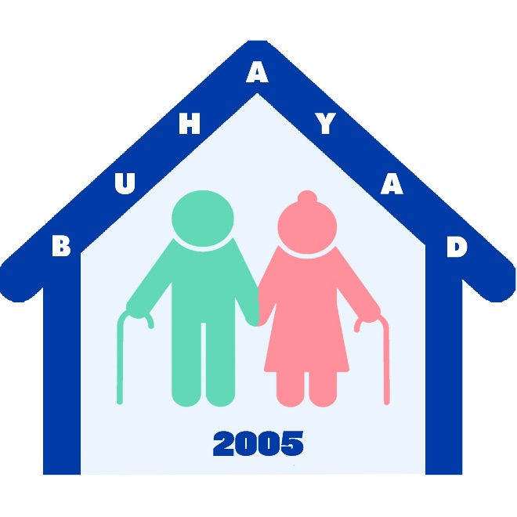
Partnership
1st Transnational Project Meeting
February 25, 2021
Agenda
Dementia Right Project
Partnership
Working methodology
DEMENTIA RIGHT | Developing a rights-based approach to dementia
Notes:
A primeira Obra em Portugal data de 1606. Com a exclaustração de 1834, a Ordem foi extinta em Portugal, tendo sido restaurada em 1891 com S. Bento Menni, sendo erigida canonicamente a Província Portuguesa a 1 de maio de 1928.

Slide 18
Partnership
1st Transnational Project Meeting
February 25, 2021
Agenda
Dementia Right Project
Partnership
Working methodology
DEMENTIA RIGHT | Developing a rights-based approach to dementia
Notes:
A primeira Obra em Portugal data de 1606. Com a exclaustração de 1834, a Ordem foi extinta em Portugal, tendo sido restaurada em 1891 com S. Bento Menni, sendo erigida canonicamente a Província Portuguesa a 1 de maio de 1928.

Slide 19
1st Transnational Project Meeting
Virtual Meeting
February 25-26, 2021

